Slide 1

Basic Communication Skills
Presented by

Slide 2
ESTABLISHING RAPPORT
Field of Consciousness

Slide 3
How do you go about Establishing Rapport?
You need Self-Confidence
You must Understand People
You must be Enthusiastic
You must make Eye Contact
You must be Interested in them

Slide 4
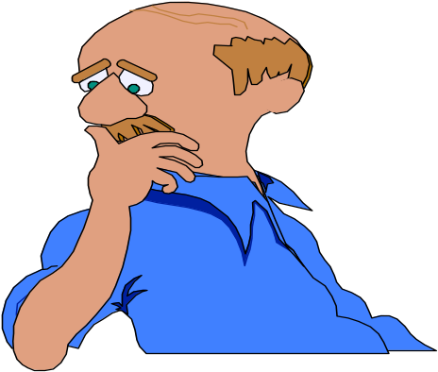
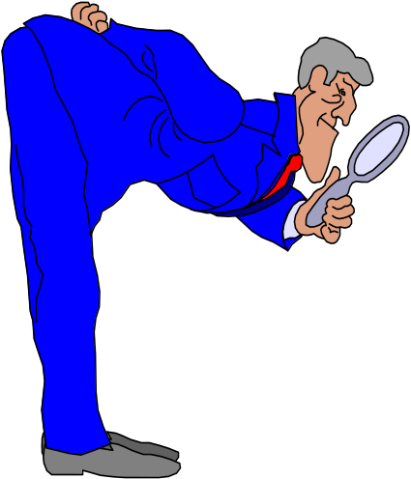
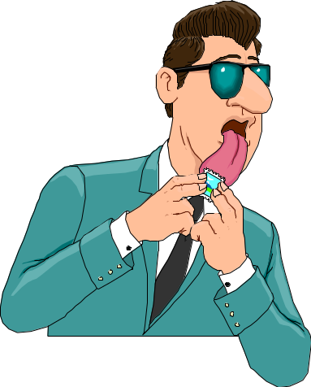
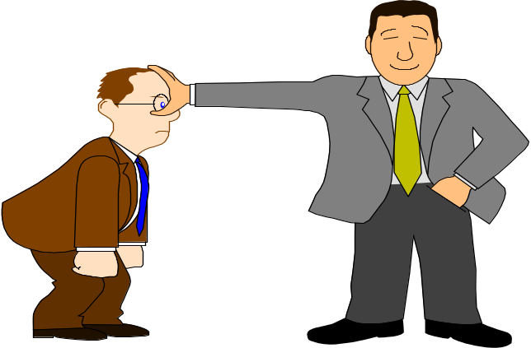
Communication is a Series of Experiences of
Hearing
Smell
Seeing
Touch
Taste

Slide 5
Communication - Meaning
Communication is a dynamic process…
through this process we convey a thought or feeling to someone else.
how it is received depends on a set of events, stimuli, that person is exposed to.
how you say what you say plays an important role in communication.

Slide 6
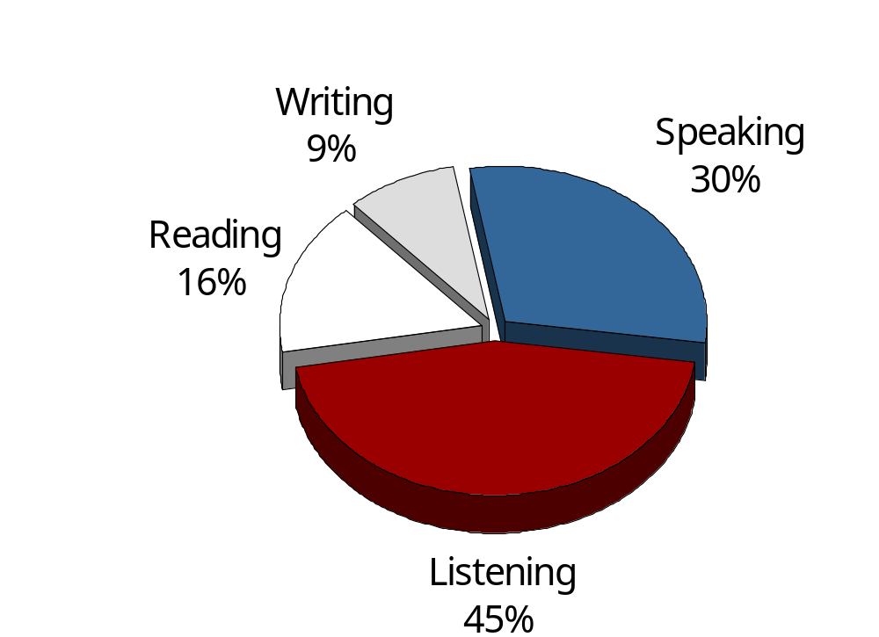
TOTAL COMMUNICATION PROCESS

Slide 7
LEVELS OF COMMUNICATION
VERBAL
  Intra verbal: intonation of word and sound
  Extra verbal verbal: implication of words and phrases, semantics
NON-VERBAL
  Gestures
  Postures
  Movements
SYMBOLIC

Slide 8
Barriers in Communication
(that have to do with the COMMUNICATOR)
Unwillingness to say things differently
Unwillingness to relate to others differently
Unwillingness to learn new approaches
Lack of Self-Confidence
Lack of Enthusiasm
Voice quality
Prejudice

Slide 9
Barriers in Communication
(that have to do with the COMMUNICATOR)
Disagreement between verbal and non-verbal messages
Negative Self Image
Lack of Feedback
Lack of Motivation and Training
Language and Vocabulary Level
Lack of Self Awareness

Slide 10
Barriers in Communication
(that have to do with the RECEIVER)
Selective Perception
Unwillingness to Change
Lack of Interest in the Topic/Subject
Prejudice & Belief System
Rebuttal Instincts
Personal Value System
Here-and-Now internal & external factors

Slide 11
External Barriers in Communication
Environment
  The venue
  The effect of noise
  Temperature in the room
Other People – Status, Education
Time

Slide 12
5 Basic reasons we Do Not Listen
Listening is Hard Work
Competition
The Rush for Action
Speed differences (120 wpm v/s 360 wpm)
Lack of Training

Slide 13
4 Levels of Listening
The Non-Listener
The Marginal Listener
The Evaluative Listener
The Active Listener

Slide 14
Improving Listening Skills
By not being Preoccupied
Being Open Minded & Non Defensive
Minimizing Interruptions
Effective Listening is: Hearing, interpreting when necessary, understanding the message and relating to it.
By Asking Questions

Slide 15
COMMUNICATION
7% WORDS
  Words are only labels and the listeners put their own interpretation on speakers words
38% PARALINGUISTIC
  The way in which something is said - the accent, tone and voice modulation is important to the listener.
55% BODY LANGUAGE
  What a speaker looks like while delivering a message affects the listener’s understanding most.

Slide 16
TYPES OF BODY LANGUAGE
Remember that you are dealing with “PEOPLE”
(P)OSTURES & GESTURES
  How do you use hand gestures? Stance?
(E)YE CONTACT
  How’s your “Lighthouse”?
(O)RIENTATION
  How do you position yourself?
(P)RESENTATION
  How do you deliver your message?
(L)OOKS
  Are your looks, appearance, dress important?
(E)PRESSIONS OF EMOTION
  Are you using facial expressions to express emotion?

Slide 17
Contact us @
Shabbar Suterwala's Leaders Workshop
B/303, Mandsaur CHS,
Kokani Pada, Kurar Village,
Malad (East), Mumbai 400 097
Ph: +91-22-28423326
Mb: +91-9892225864
Email: LeadersWorkshop@mtnl.net.in
shabbarsuterwala@hotmail.com
Join our eGroup at: http://finance.groups.yahoo.com/group/LeadersWorkshop

